Slide 1

Team Software Project: Uni Marketplace
Team:
Hrithik Chandra
Jemima Anil George
Anderson Sugianto
Sujan Gurung
Mahfuza Begum

Slide 2

Team Software Project: Uni Marketplace
Team
Hrithik Chandra
Jemima Anil George
Anderson Sugianto
Sujan Gurung
Mahfuza Begum

Slide 3


Slide 4
Uni Marketplace: For Students, By Students
Aims :
To design and prototype an online marketplace platform providing the means to sell or buy good quality second-hand products to Students, by Students.
Allow access to a database of second-hand products showing facts such as price, product description (image, video), Seller contact information, location of university.
Allow users to put products they want to buy later into Wishlist.
Allow users to sell their products.
Allow users to message the sellers.
Provide access to a map system that allows users to determine their pick-up/drop-off location at the university.
Allow users to report damaged or inappropriate items
Allow users to use either mobile app or website versions as per convenience.

Slide 5
What we are trying to Solve
Notes:
The Problem Statement :
We are trying to solve the lack of easy access to Sell or Purchase good-quality used products. This is because every student may not be having sufficient financial ability to afford first-hand products.
Thus, making lives of university students easier by providing them means to buy affordable products or be able to sell what they don’t need anymore
---------------------------------------------------------------------------------------------------------------------------------------------------------------------------------------------------------
Why the project is created –
Even though there are popular online platforms dealing in second hand products available (like Amazon, eBay, Facebook marketplace, Vinted, etc.), they are not focussed on a University Student’s specific needs; hence the search becomes complex.
Also, the Sellers of the platform may not be Students, or they may be living far away,
Hence, the buyer may end up paying an additional delivery charge.
And they physical verification of the quality and usability of the product becomes impossible.
---------------------------------------------------------------------------------------------------------------------------------------------------------------------------------------------------------
Who benefits most –
The main beneficiary of this project are students
---------------------------------------------------------------------------------------------------------------------------------------------------------------------------------------------------------

Slide 6
How we are creating it
We originally planned to build a website, but now we are building a responsive design, addressing both website and mobile via web app approach.
This is because, after thinking through the student persona, we realised that for this application to be simple, intuitive and usable on the go, we as students would prefer a mobile version. But since for certain features to work efficiently, and personal choice, we would also need a website version.
Hence, we are making this as a Responsive Web app, so that we can have both versions, with similar designs, making it a versatile platform.
Notes:
How ?
We plan to create a niche marketplace experience, where students Buy or Sell products seamlessly.
This will be a mobile friendly experience, so that Students can use it on the go, as well as on their PCs ( Responsive UI Design ).
The experience will be intuitive and as per Usability Standards.
What are Usability Standards ? --- ( UX – User Experience || UI – User Interface )
It means that the design is user-centric and will minimal effort to navigate through the application.
---------------------------------------------------------------------------------------------------------------------------------------------------------------------------------------------------------
For example, a Student, may have bought or brought an item, let’s say, a rice cooker, and they want to sell it, as they don’t need it anymore ( for some reason, like they have finished their course, or they don’t like rice anymore ). And, from the goodness of their heart, they want to sell that item to other fellow students/classmates, who maybe in need of a rice cooker.
Here, we provide them with this platform, for this transaction to take place.
Delivery/Pickup of any products will be within/ around the University campus
---------------------------------------------------------------------------------------------------------------------------------------------------------------------------------------------------------
What technology we will be using to create this
Web Server – Apache
Front-End – PHP, HTML, CSS
( We are not using python as making webpages involves using a Framework like Django or Flask, which needs an experienced person to setup and configure )
Backend – Oracle/MySQL
Hosting – private hosting ( to be decided later )
OR
Make the whole thing in Wix
---------------------------------------------------------------------------------------------------------------------------------------------------------------------------------------------------------

Slide 7
HOW THIS PLATFORM WORKS –
Assumptions :
Seller’s Perspective :
Seller uploads the pictures/videos of the item, a proper description, specifying category, brand, Condition, How old it is, price, selling start and end dates and seller’s contact information.
Seller agrees to only two forms of payment – Cash or Bank Transfer
In the Selling Page, there is an inventory of all the items that the Seller has already sold, and those pending sale.
The transaction process specifies when the sale is going to happen, pick-up/drop-off point and mode of payment (cash or direct online transfer)
There is also a Summary page, where all items sold are listed (or all past transactions details) and the total profit.
Buyer’s Perspective :
Buyer selects the item that they want to purchase --
If they wish to buy it immediately, they LOCK THE DEAL , the Seller, gets a notification that the item has been “locked”.
If a customer, wants to buy that item, the seller receives a message from the customer, and they discuss about the process of transaction
The buyer contacts the seller to discuss about the date, time, location of the purchase.
Mode of payment decided by the buyer
If they want further information or evidence of the product, they can message the seller and they must provide it.

Slide 8
Potential Features
Primary Features –
Only Uni students can access; requires authentication – Sign up/ Log in using Uni email, 2-FA
Filter products based on product type, price;
Sorting products based on Price, Trending Product Type
Shopping Cart (Individual, total price, mode of payment)
Primarily selling Second hand products, and free ones.
Secondary Features –
Multiple university and university log ins
Map location of drop off/pick up points
Payment on delivery, Cash or Card/Contactless, Direct Transfer.
Multiple drop off/pick up points around/in Uni for delivery or picking up delivery.
Returning Product and Payment in-case of defective product; Wishlist;

Slide 9
Roles
Hrithik Chandra | Jemima Anil George | Anderson Sugianto | Mahfuza Begum | Sujan Gurung
Current Team Leader and Website Design | Research Lead | Mobile version Design | Visual Artist – Colour schemes, Fonts, Logo | Website Design
Research into – Research on platform and technology choice | Research into – Related Security and Privacy research and associated laws | Research into Design – Benchmark sites; Key Features | Research into Design – Standard design principles; human centric; Accessibility and Usability | Research into – Research on similar sites (competition)
Website Design Mock up | Website Design Mock up | Mobile Design Mock up | Logo Designs Mock up | Website Design Mock up
Team GitHub, Trello Management | Gantt Chart Production and Management |  | Minute Taker
Coding/Building | Coding/Building | Coding/Building | Coding/Building | Coding/Building

Slide 10
Research
Notes:
Research on similar sites (competition) – Reason why those sites are not suitable (product ideas) or are not a proper solution for our Problem Statement
Too much of cluttering
Unrelated product listing which are not relevant for student life
Prohibitive costs for products – not suitable for students with limited revenue source
These can be some background of building a uni specific marketplace.
---------------------------------------------------------------------------------------------------------------------------------------------------------------------------------------------------------
Research on design (design ideas)
What all sites were referred for benchmark
Looking at standard design principles – human centric, accessibility and usability (W3C, WCAG etc sites)
Design thinking principles leading to material design approach of google
---------------------------------------------------------------------------------------------------------------------------------------------------------------------------------------------------------
Related Security and Privacy research and associated laws
1. Securing data (user, product and transactions (not financial but any data exchanges happening)
2. Related laws that would apply (GDPR, Ethical standards related to the exchanges via this application (products or information)
---------------------------------------------------------------------------------------------------------------------------------------------------------------------------------------------------------
Research on platform and technology choice
Whether to use tech and build ground up or leverage a hosting provider like Wix

Slide 11
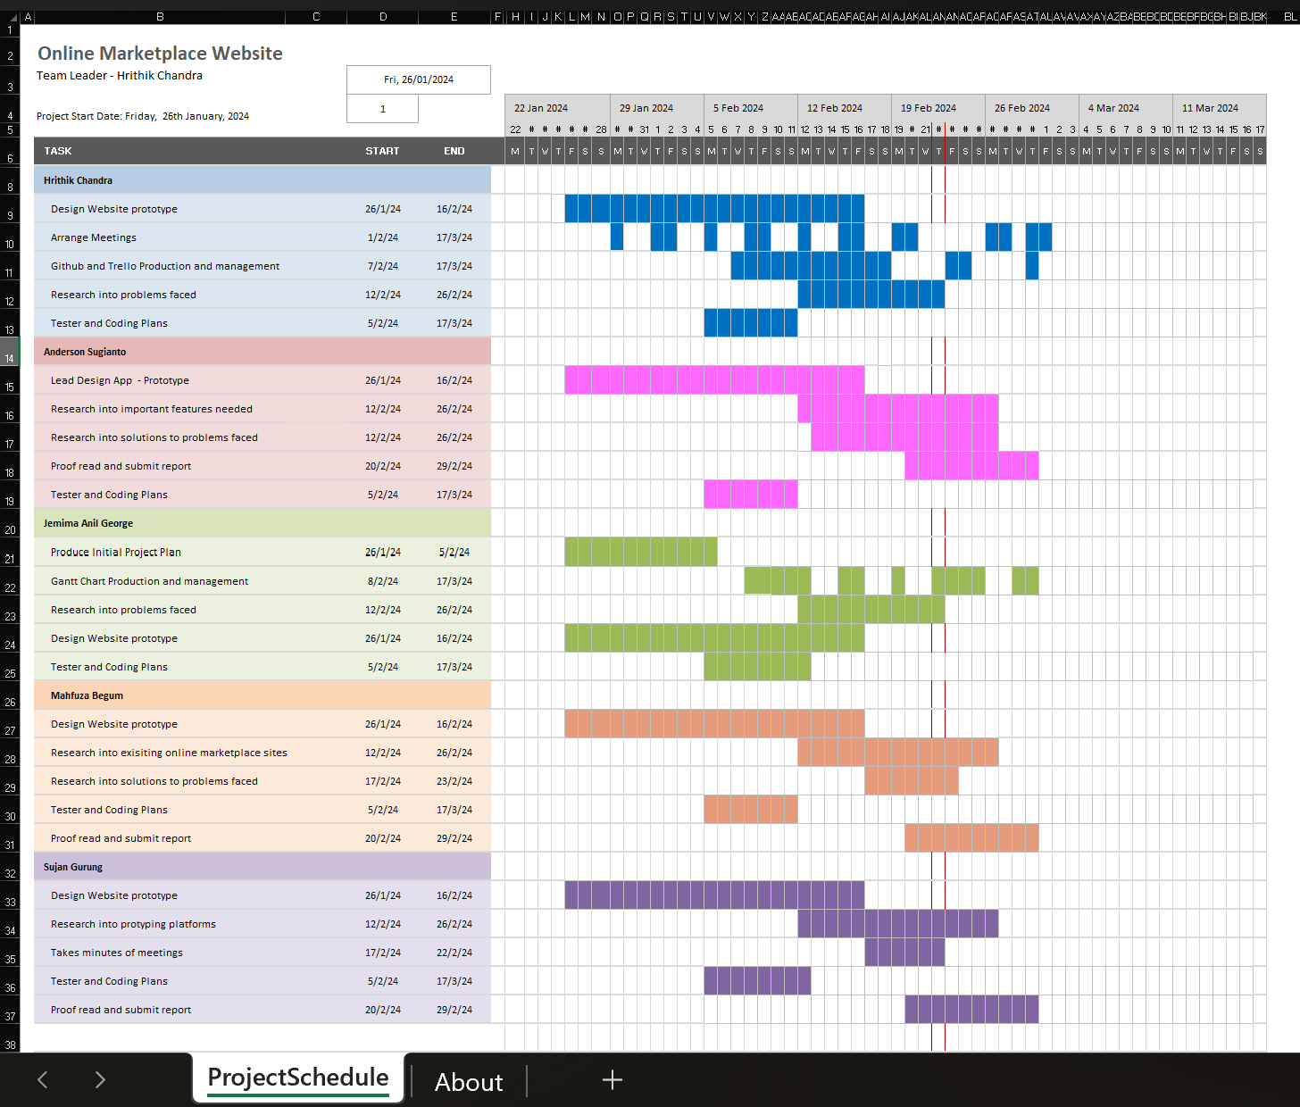
Gantt Chart
This is our Gantt Chart.
It is a visual tool used for project management.
It helps us to know the deadlines and status as well as who's responsible for each task in the project.
(btw proofread means to read and check errors)

Slide 12
Wireframe – our designs
Our final designs should be interactive and have colour.
Wireframe – exact opposite

Slide 13
Hrithik’s Work To Date

Slide 14
Jemima’s Work To Date

Slide 15
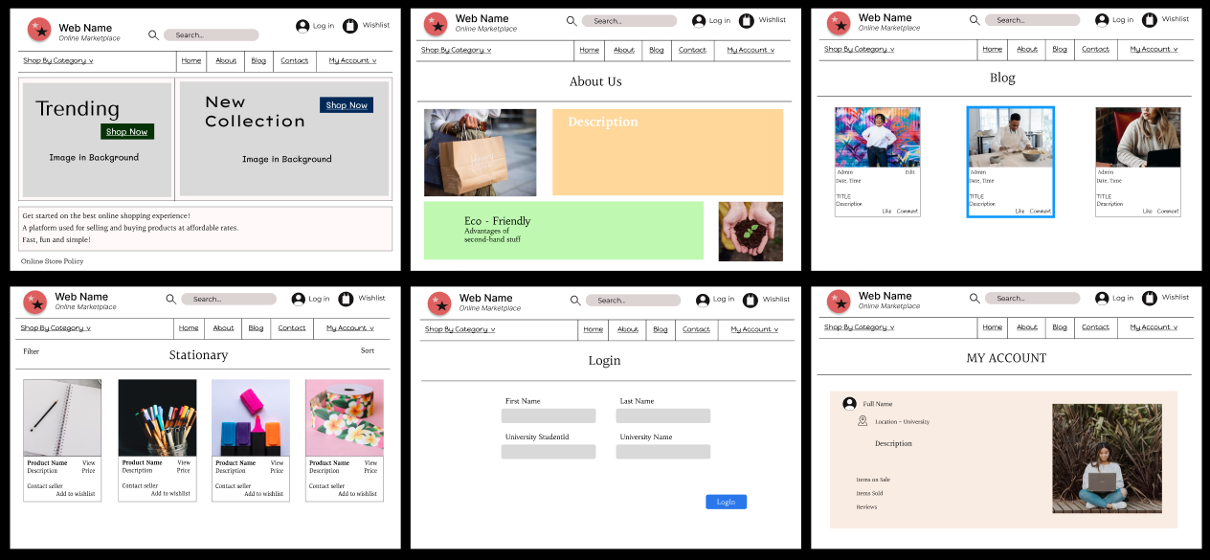
Jemima’s Work To Date

Slide 16
Anderson’s Work To Date
My responsibilities in the group are to serve as a Design Lead for the mobile application. I have conducted the following work to date
Research into online shopping applications; I did research on eBay, Vinted and Depop and took design inspirations for certain features from them.
Designed a mobile application prototype for this project in Figma.

Slide 17
Anderson’s Work To Date
Your version
eBay:
Audience: operates internationally, allowing users to buy and sell items from around the world.
Categories: eBay offers a vast range of products across multiple categories, including electronics, fashion, collectibles, and more.
Buy It Now: Alongside auctions, eBay also offers fixed-price listings with the "Buy It Now" option.

Slide 18
Anderson’s Work To Date
eBay:
1. Wide Variety: eBay offers a vast range of products across multiple categories, including electronics, fashion, collectibles, and more.
2. Auction Format: One of eBay's distinguishing features is its auction-style listings, where users can bid on items.
3. Buy It Now: Alongside auctions, eBay also offers fixed-price listings with the "Buy It Now" option.
4. Global Marketplace: eBay operates internationally, allowing users to buy and sell items from around the world.
5. Seller Tools: eBay provides sellers with various tools and features to manage their listings, such as seller analytics and promotional options.
Vinted:
1. Focus on Fashion: Vinted specializes in second-hand clothing, shoes, and accessories, catering to a fashion-forward audience.
2. Peer-to-Peer Marketplace: Users primarily buy and sell items directly to each other, fostering a sense of community.
3. Simple Selling Process: Vinted emphasizes an easy listing process, allowing users to quickly upload photos and descriptions of their items.
4. Feedback System: Similar to eBay, Vinted has a feedback system where buyers and sellers can rate each other based on their transactions.
5. Shipping Integration: Vinted often includes shipping costs within the listing price, making the purchasing process straightforward for buyers.

Slide 19
Anderson’s Work To Date
Depop:
Fashion and Lifestyle: Depop focuses on unique fashion and lifestyle items, including vintage and handmade goods.
2. Social Commerce: Depop integrates social features, such as following other users and liking items, creating a social shopping experience.
3. Discovery and Inspiration: Depop's Explore page and curated collections provide users with inspiration and help them discover new items and trends.
4. Youthful Audience: Depop has gained popularity among younger demographics, particularly Gen Z, due to its trendy and alternative offerings.
5. Seller Customization: Sellers on Depop can customize their shop profiles and create a distinct brand identity, enhancing their visibility and appeal.
Conclusion:
These are some of the key features that differentiate eBay, Vinted, and Depop in the mobile shopping app landscape. Each platform targets slightly different demographics and offers unique selling propositions to their users.

Slide 20
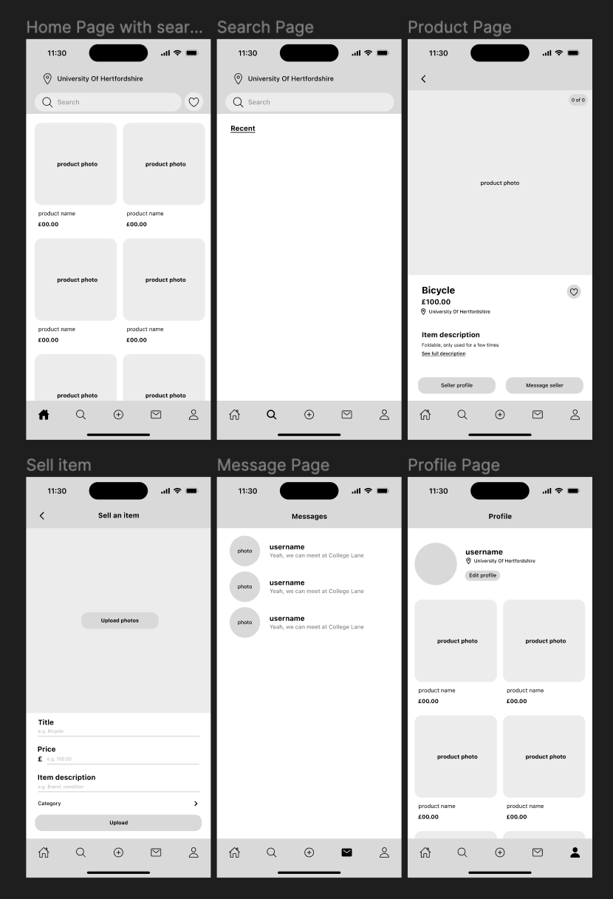
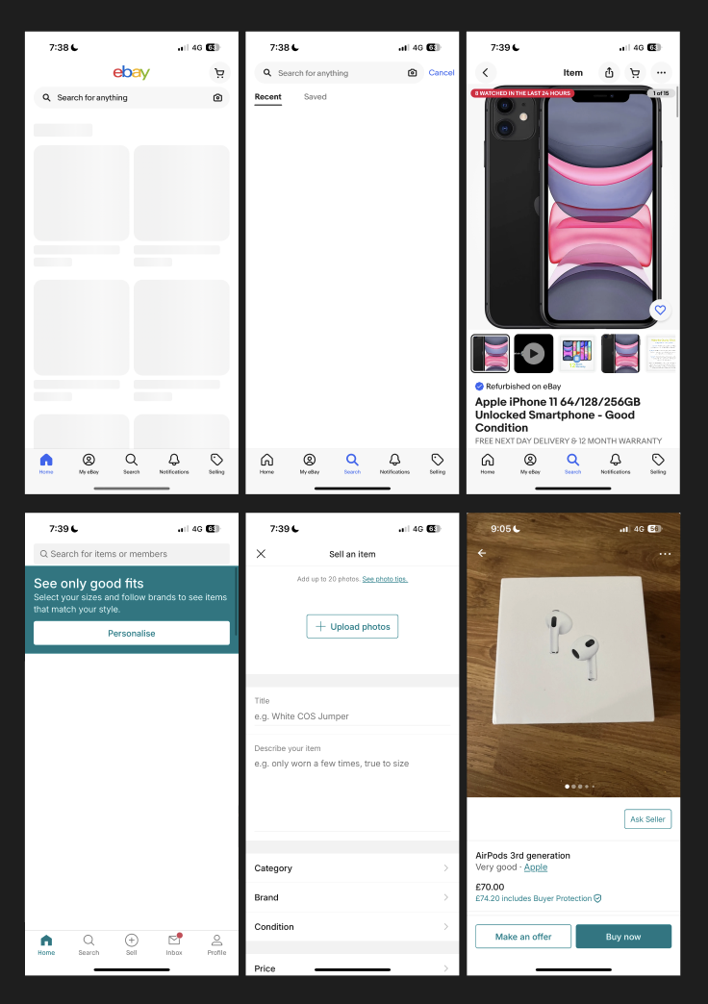
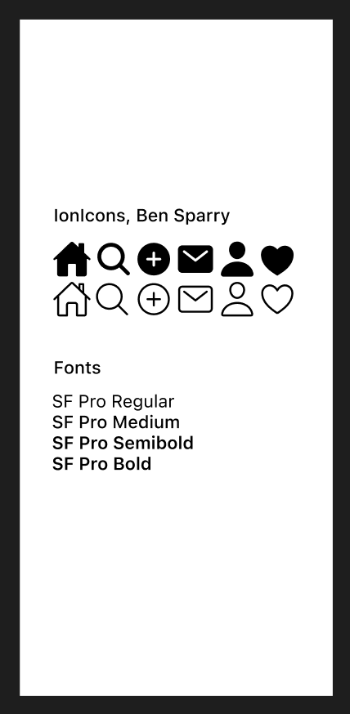
Anderson's Work to Date
Designs
References

Slide 21
Mahfuza’s Work To Date

Slide 22
Sujan’s Work To Date

Slide 23
Final Design
Realisation that mobile app would be more convenient than website
Can do a poll
Then decided to make a web app as final design (combining all our ideas) – platform that can be used on both laptop and phone based on convenience.

Slide 24
Project Management

Slide 25
Tasks remaining

Slide 26
Minutes of Meeting - Agenda
Meetings scheduled every week on Thursdays, Fridays (hybrid)

Slide 27
References
Production Sources -
Figma - Figma: The Collaborative Interface Design Tool
GitHub - Arcy-03/Team-Software-Project-L4 (github.com)
Trello - TSP - Uni Marketplace | Trello
Iconify - https://iconify.design
Design Inspiration Sources -
Amazon (Mobile and Website) - Amazon.co.uk: Low Prices in Electronics, Books, Sports Equipment & more
eBay (Mobile and Website) - Electronics, Cars, Fashion, Collectibles & More | eBay
Patagonia - Patagonia Outdoor Clothing & Gear
Depop - Depop - buy, sell, discover unique fashion
Vinted - Vinted | Sell and buy clothes, shoes and accessories
Accessibility and Usability –
WCAG 2 Overview | Web Accessibility Initiative (WAI) | W3C
Best Practices for Mobile App Usability from Google | IxDF (interaction-design.org)

